Slide 1

Rajiv Gandhi University of knowledge and technologies Srikakulam department of electronics and communication engineering
Mini Project -2
DIGITAL IMAGE PROCESSING USING MATLAB
TECHNIQUES AND APPLICATIONS
BATCH-28
PROJECT GUIDE:
Ms. Y Laxmi Prasanna Mam, M.Tech
Assistant Professor
ECE Department.
GROUP MEMBERS:
M.Chandra Rao (S190534)
M. Sirisha ( S191059)
D. Sai Jagadeesh (S190023)
K. Radha Rani (S190145)
K. Yamuna (S190768)
N. Mounika (S190823)

Slide 2
Contents
Abstract
Introduction
Basic operations in MATLAB
Image Enhancement
Image Restoration
Color Image Processing
Advanced Topics
MATLAB Tool Box for Image Processing
Literature Review
Applications
Conclusion
Future Scope

Slide 3
abstract
Image processing plays a vital role in modern technology, enabling the extraction of valuable information from digital images for various applications. This project focuses on the implementation of image processing techniques using MATLAB to enhance feature extraction and analysis. The primary objectives include improving image quality, detecting and enhancing key features, and developing algorithms for efficient image-based decision-making.
The results of this project demonstrate the effectiveness of the proposed image processing techniques in improving the accuracy and efficiency of feature extraction and analysis.
The MATLAB-based implementations provide a user-friendly platform for researchers and practitioners to apply these methods to their specific domains.

Slide 4
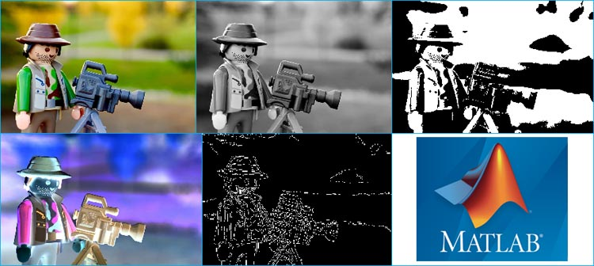
INTRODUCTION
Digital image processing stands as a cornerstone of modern technology, facilitating the extraction of valuable insights from digital images across various domains. This presentation is advanced image processing techniques implemented through MATLAB, aimed at augmenting feature extraction and analysis. Our primary focus lies in elevating image quality, pinpointing and enhancing critical features, and crafting algorithms conducive to efficient decision-making based on image data. Leveraging MATLAB as our platform of choice, our implementations offer a user-friendly avenue for researchers and practitioners alike to seamlessly integrate these techniques into their specific domains.

Slide 5
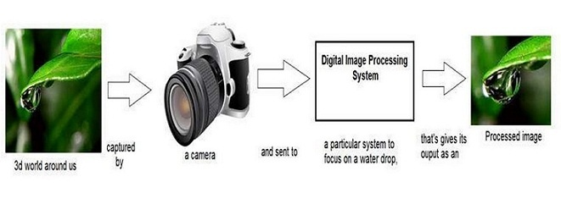
Definition of Image Processing: Image processing involves manipulating digital images to improve their quality or extract useful information from them.
Importance and Applications: Image processing is crucial in various fields such as medicine, surveillance, and remote sensing for tasks like diagnostics, object detection, and analysis.
Brief Overview of MATLAB for Image Processing: MATLAB provides a robust environment for image processing with built-in functions and tools for efficient manipulation and analysis of images .In this section, we will delve into the fundamentals of image processing, discussing its definition, significance across different industries, and how MATLAB serves as a valuable platform for implementing advanced image processing algorithms.

Slide 6
Basic Image Operations in MATLAB:
Basic image operations form the foundation of image processing. MATLAB simplifies tasks like loading images, accessing pixels, performing arithmetic operations, and resizing images, making it efficient for beginners and experts in image processing alike.
Manipulating Images with MATLAB
• Loading and Displaying Images: MATLAB allows users to load and display images in various formats, making it easy to work with different image types.
• Accessing Image Pixels: Image pixels can be accessed individually in MATLAB, enabling precise manipulation and analysis of image data.
• Basic Image Arithmetic: Arithmetic operations such as addition, subtraction, and multiplication can be performed on images to enhance or modify them.
• Image Resizing and Cropping: Images can be resized or cropped in MATLAB to adjust their dimensions or focus on specific regions of interest.

Slide 7
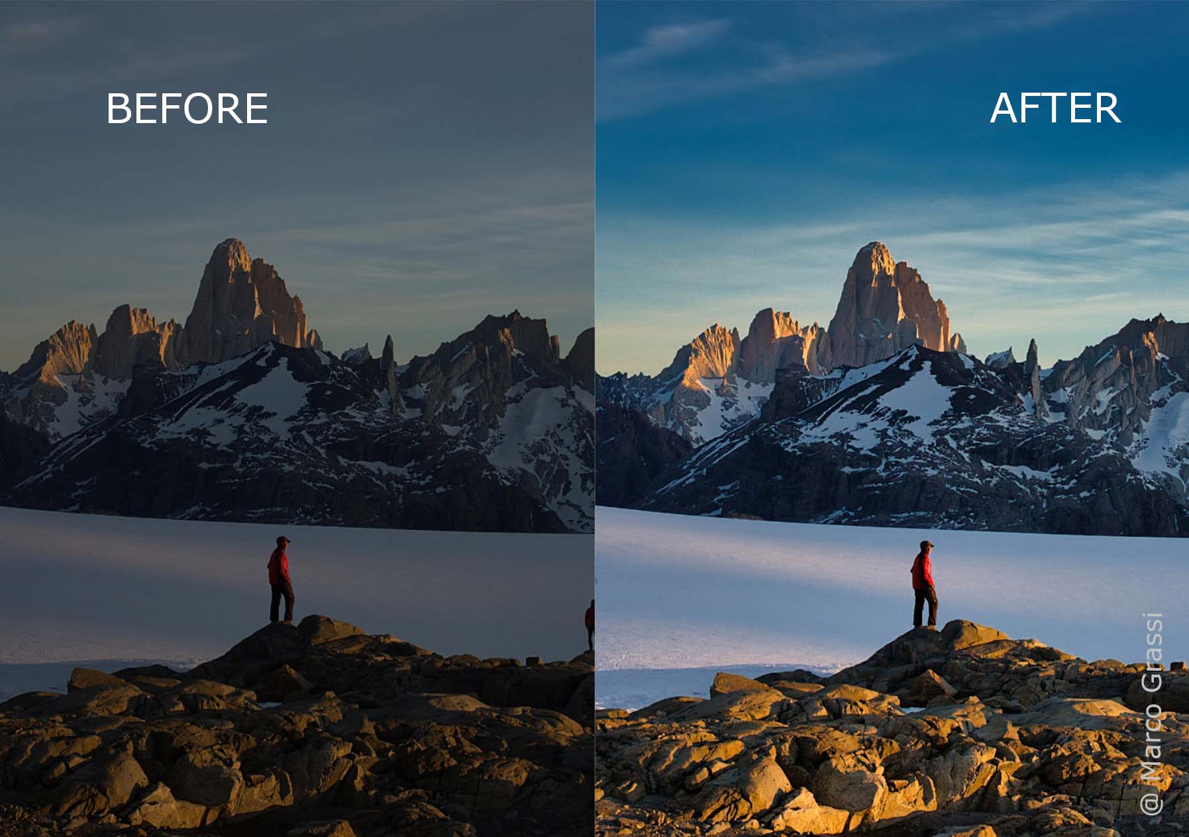
Image Enhancement:
Image enhancement techniques play a crucial role in improving the visual quality and interpretability of digital images. Techniques like histogram equalization and contrast stretching optimize the contrast and brightness levels, bringing out hidden details. Filtering operations, including low- pass, high-pass, and band-pass filters, manipulate the image's frequency content to enhance specific features. Sharpening filters fine-tune image sharpness by accentuating edges and details, creating a more visually appealing result.

Slide 8
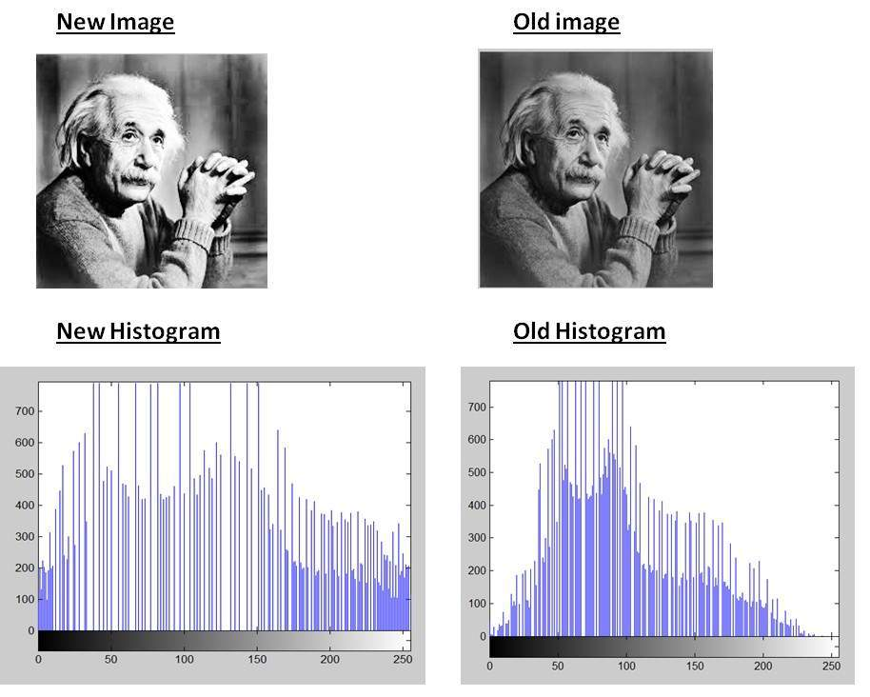
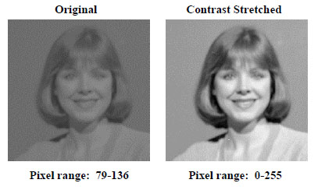
Image Enhancement Techniques:
Histogram Equalization: Histogram equalization is a technique used to improve the contrast of an image by redistributing pixel intensities evenly across the histogram, enhancing the overall visibility of details and features.
Contrast Stretching: Contrast stretching expands the range of pixel values in an Image, effectively Increasing the visual contrast between dark and light areas, leading to a more vibrant and detailed representation.

Slide 9
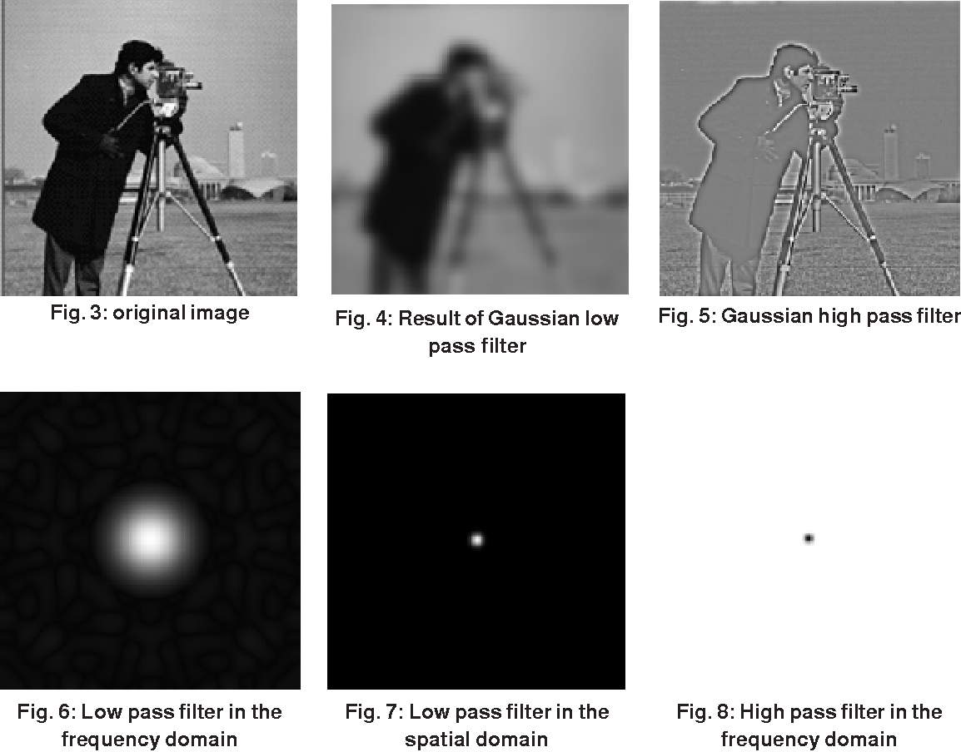
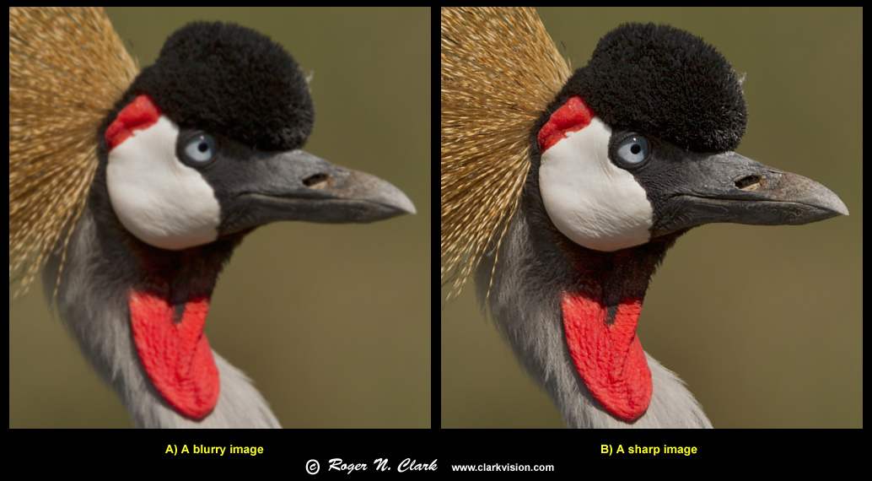
Filtering (Low-pass, High-pass, Band-pass):
Filtering techniques in image enhancement involve applying filters to modify the frequency content of an image. Low-pass filters smooth out variations, high-pass filters enhance edges and band-pass filters focus on specific frequency bands, each contributing to improving image quality.
Sharpening Filters:
Sharpening filters enhance the details and edges in an image by emphasizing the high-frequency components, resulting in a crisper and more defined appearance of the objects within the image.

Slide 10
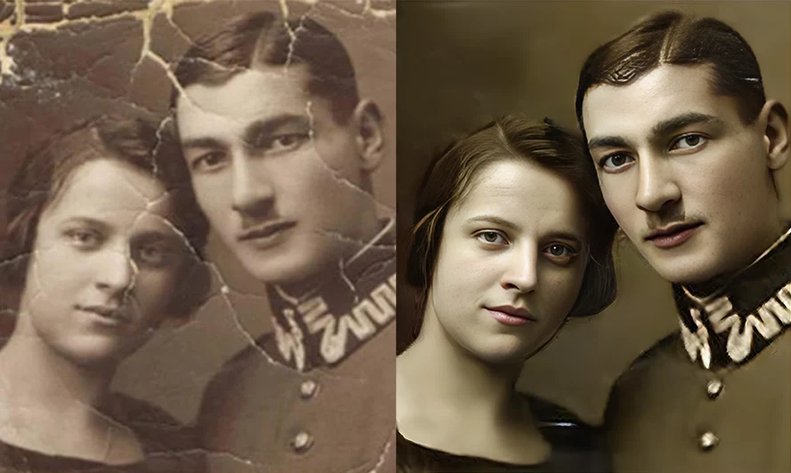
Image Restoration:
Image restoration techniques focus on recovering the original quality of an image that has been degraded by noise or blurriness. Various noise reduction methods, such as filtering out Gaussian or salt-and- pepper noise, help in restoring image integrity.

Slide 11
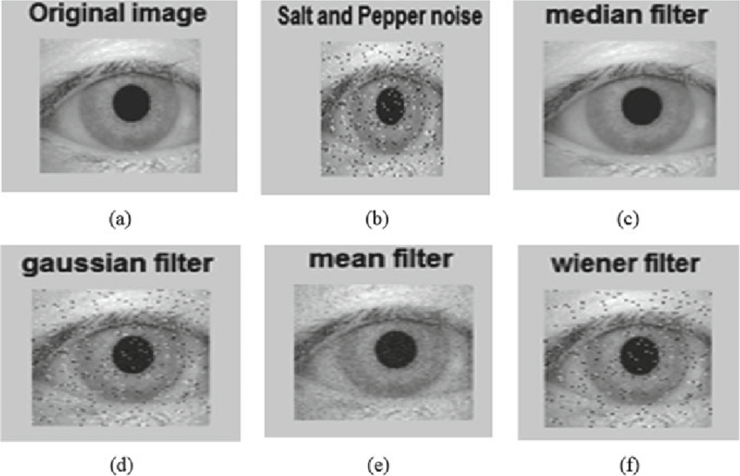
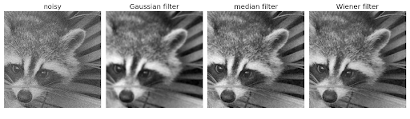
Image Restoration Techniques:
Noise Reduction Techniques (e.g., Gaussian, Salt and Pepper): Noise reduction methods aim to remove unwanted disturbances in an image, such as Gaussian noise or salt-and- pepper noise, which can deteriorate image quality and affect visual interpretation. Techniques like smoothing filters and statistical methods help in restoring the original image clarity.
Restoration Filters (e.g., Wiener Filter, Inverse Filter):
Restoration filters like the Wiener filter and inverse filter are used to recover the degraded image caused by noise or blur. These filters utilize mathematical models to estimate and minimize noise effects, resulting in a cleaner and sharper image.

Slide 12
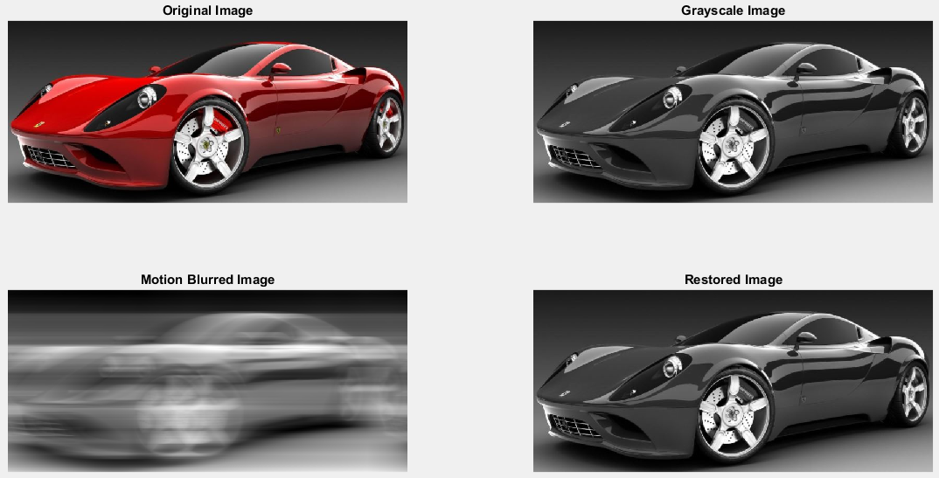
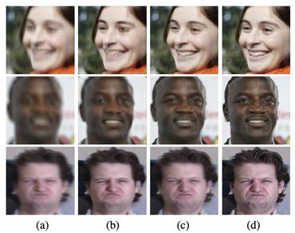
Deblurring Techniques:
Deblurring techniques address issues of image blurring caused by motion or optical distortions. By analyzing the degradation process, deblurring algorithms aim to reverse the effects and restore the image to its original sharpness and clarity.

Slide 13
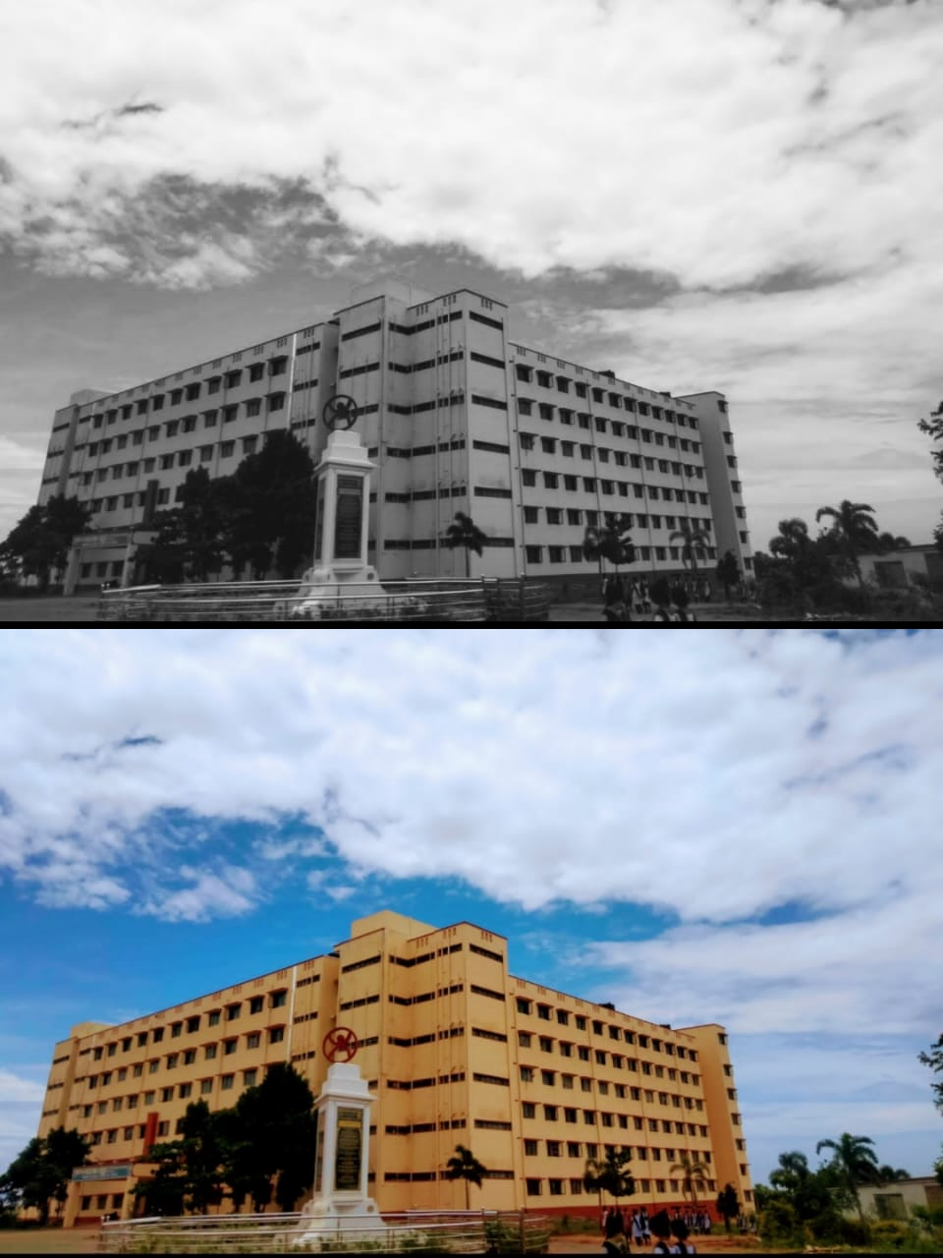
COLOR IMAGE PROCESSING:
Color image processing is an area that has been gaining its importance because of the significant increase in the use of digital images over the Internet. This may include color modeling and processing in a digital domain etc.

Slide 14
COLOR IMAGE PROCESSING TECHNIQUES
Color Enhancement: Adjusting the color balance, contrast, brightness, and saturation to improve the overall appearance of the image.
Color Filtering: Applying filters in specific color channels to enhance or suppress certain colors in the image.
Color Segmentation: Dividing an image into regions based on color similarity, which is useful for object detection and tracking.
Color Histogram Equalization: Equalizing the color histograms to improve the overall contrast and brightness distribution of the image.
Color Edge Detection: Detecting edges based on color gradients to identify boundaries between different objects or regions in the image.

Slide 15
Advanced Topics:
Exploring advanced topics in image processing delves into complex operations and methodologies that enhance image analysis capabilities.
1.Morphological operations reshape image structures through dilation and erosion, aiding in noise reduction and feature enhancement.
2.Image registration aligns images for comparative analysis, enabling tasks like change detection and composite image creation.
3.Image compression techniques optimize storage and transmission efficiency by reducing redundant data, ensuring an optimal balance between image quality and file size.

Slide 16
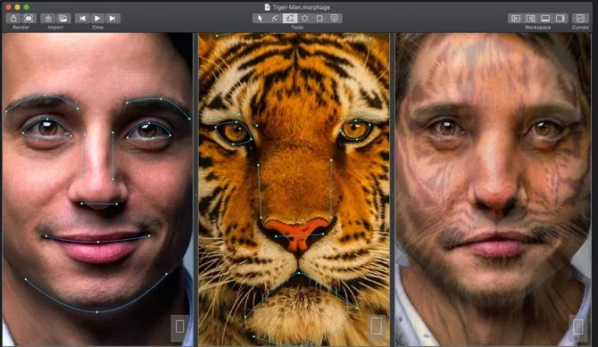
Morphological Operations:
Morphological operations manipulate the shapes and structures of objects within an image by applying operations like dilation, erosion, opening, and closing. These operations are used for tasks such as noise removal, object detection, and shape analysis.

Slide 17
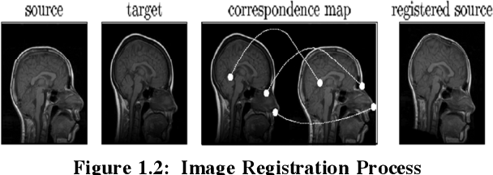
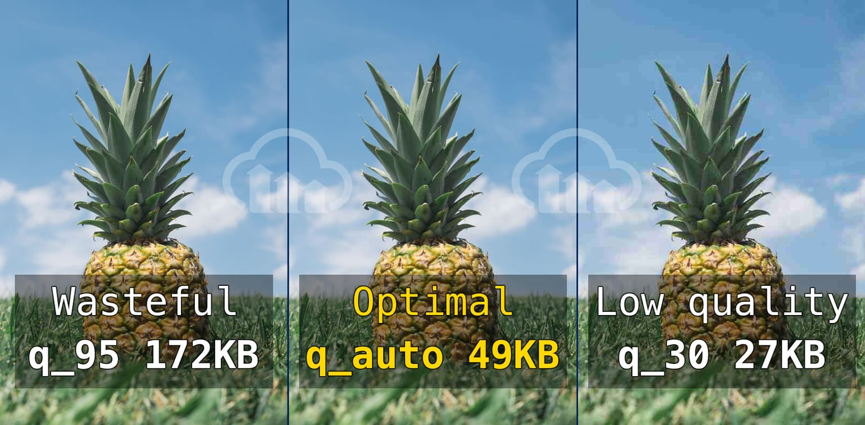
Image Registration:
Image registration aligns multiple images of the same scene or object to facilitate comparison and analysis. By matching corresponding features and geometric transformations, image registration enables image fusion, change detection, and 3D reconstruction.
Image Compression Techniques:
Image compression techniques reduce the size of image data by encoding and storing information more efficiently. Lossy compression methods discard non-critical image details, while lossless compression retains all original data, balancing between image quality and file size.

Slide 18
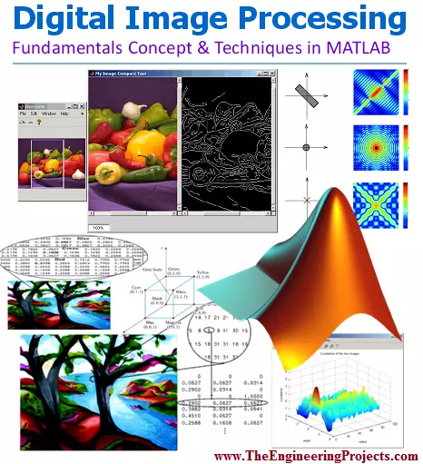
MATLAB Toolbox for Image Processing:
MATLAB's Image Processing Toolbox serves as a comprehensive resource for performing a wide array of image processing tasks efficiently and effectively. With a rich collection of functions and tools, users can seamlessly execute operations ranging from basic image manipulations to advanced analysis. Key functions cover essential areas like image enhancement, restoration providing a holistic toolkit for in-depth image processing. Real-world code snippets offer practical insights into implementing these techniques, empowering users to leverage MATLAB for diverse image processing needs

Slide 19
Overview of Image Processing Toolbox:
The Image Processing Toolbox in MATLAB offers a wide range of functions and tools for image manipulation, analysis, and enhancement. It provides efficient algorithms for tasks like image filtering, morphological operations, and feature extraction, simplifying complex image processing procedures.
Key Functions and Tools:
Key functions in the Image Processing Toolbox include image enhancement techniques, image restoration filters, Image segmentation algorithms, and feature extraction tools. These functions enable users to perform diverse image processing tasks with ease and precision.
Examples of MATLAB Code Snippets: MATLAB code snippets demonstrate the practical implementation of image processing techniques using functions from the Image Processing Toolbox. These examples showcase the step-by-step application of algorithms for tasks like image enhancement, restoration, and segmentation, aiding in understanding and utilization of MATLAB's image processing capabilities.

Slide 20
LITERATURE REVIEW:
S.NO | TITLE | JOUR-NAL | ADVANTAGES | DISADVANTAGES
1 | Retinal vessels segmentation based on dilated multi-scale convolutional neural network | IEEE(2019) | High efficiency,accurate segmentation. | Large data requirement,overfitt-ing.
2 | Animal classification using facial images with score-level fusion | IEEE(2018) | Ease of data collection,individual data collection. | Technical challenges,limited species applicability.
3 | Complete blood check using image processing | IEEE(2021) | Speed ,accuracy,cost-effective is very high | Complexity,interpr-etation challenges
4 | Sleep detection system using matlab image processing | IEEE(2023) | A non-invasive system for detecting the closing of eyes of a person | Difficult to implement

Slide 21
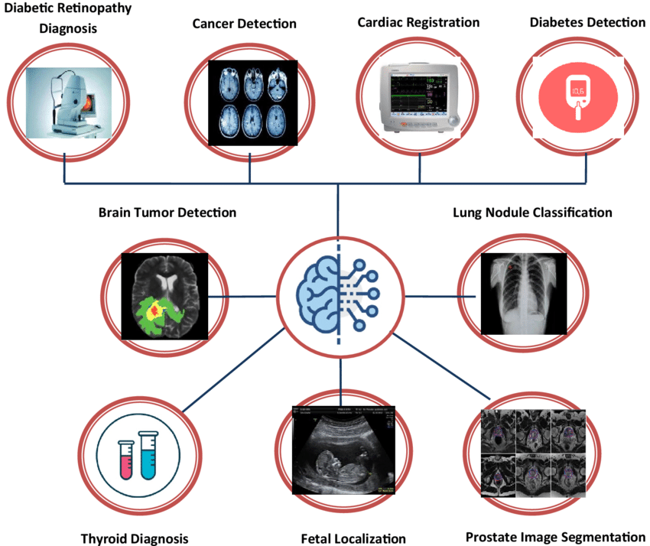
Applications of Image Processing:
The diverse applications of image
processing span across various fields,
offering solutions and enhancements in
critical domains such as Medical
imaging , Surveillance & Security, Remote
sensing and Industrial Inspection etc.

Slide 22
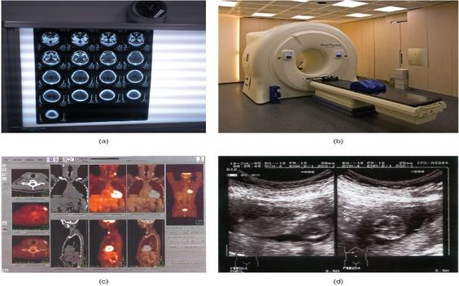

Medical Imaging:
In medical Imaging, Image processing techniques aid in diagnosis, treatment planning, and patient monitoring by enhancing medical scans, detecting abnormalities, and visualizing internal structures with precision and detail.
SURVEILLANCE ,SECURITY:
In surveillance systems, image processing plays a crucial role in real-time monitoring, object detection, and behavior analysis for enhancing security measures and identifying potential threats in public spaces and sensitive areas.

Slide 23
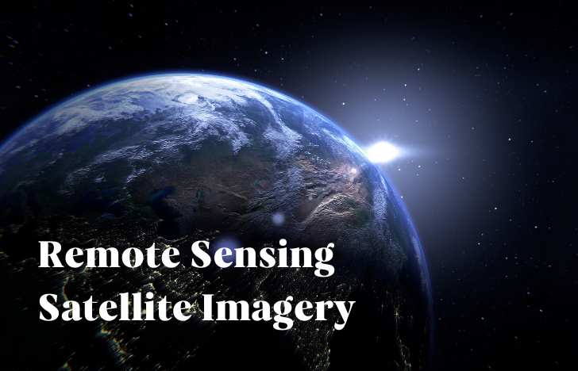
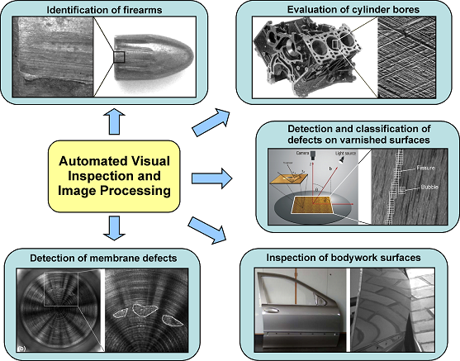
Remote Sensing:
Remote sensing applications utilize image processing for analyzing satellite imagery, monitoring environmental changes, and mapping terrain features to support tasks like agricultural planning, disaster response, and natural resource management.
Industrial Inspection:
Image processing technologies are applied in industrial sectors for quality control, defect detection, and product inspection, automated visual analysis and evaluation.

Slide 24
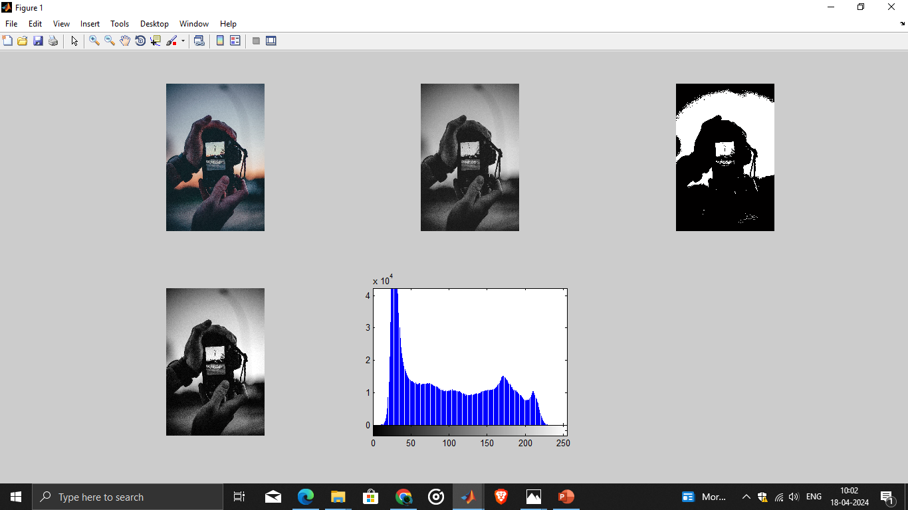
Expected output

Slide 25
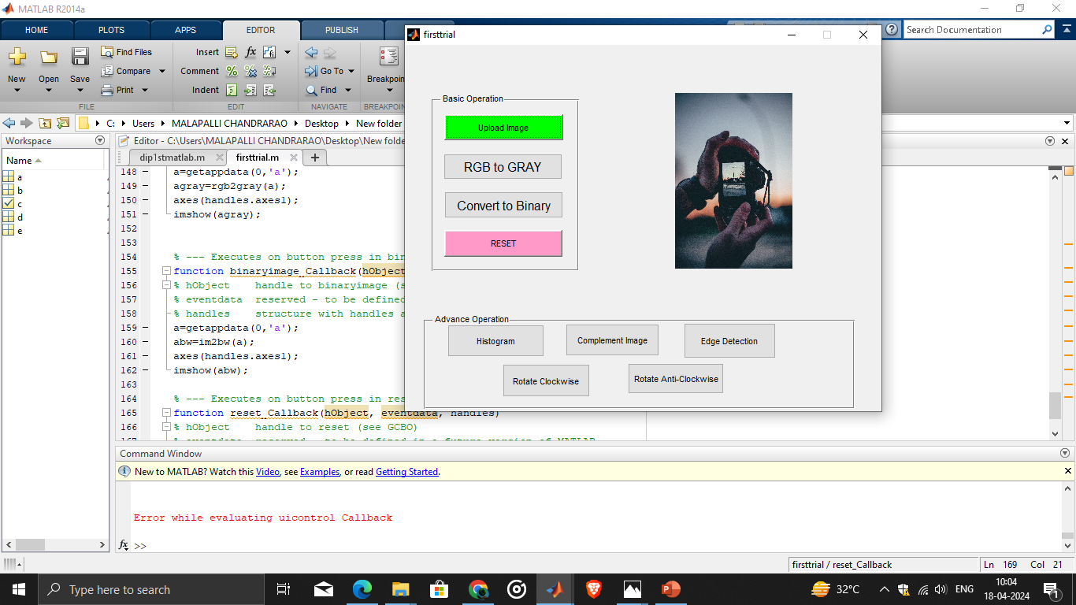

Slide 26
Conclusion:
The image processing techniques in MATLAB unveils a dynamic landscape of tools and methods that empower users to manipulate and analyze digital images for various purposes. From enhancing image quality to extracting meaningful features, each technique offers a unique perspective on visual data processing, showcasing the immense potential and versatility of image processing in unlocking insights and generating impactful results.

Slide 27
FUTURE SCOPE:
Image processing has come a long way but the future holds even more exciting prospects.with the advent of artificial intelligence,augmented reality,and advancements in various industries,image processing will play a vital role in transforming the way we perceive and interact with the world.

Slide 28


